Slide 1






⥫
Mitigating SQL Injection Vulnerabilities in a Login Page
Muhammad Shahmir 21K-3563
Khizer Nadeem 21K-4768
Danial 21K-3577

Slide 2






Introduction
SQL injection vulnerabilities pose a significant threat to the security of web applications, allowing attackers to execute malicious SQL queries and potentially compromise databases. This report outlines a project designed to address various types of SQL injection attacks by implementing robust security measures and best practices. The project focuses on preventing classic SQL injection as well as more advanced techniques such as blind SQL injection and time-based SQL injection.

Slide 3





What is SQL Injection
SQL injection attacks occur when malicious users exploit vulnerabilities in web applications to inject malicious SQL code into input fields. This injected SQL code can then be executed by the application's database server, leading to unauthorized access, data manipulation, or other malicious activities.

Slide 4





Project Overview
Our project consists of developing a login portal for a web application, incorporating various security measures to prevent SQL injection vulnerabilities including prepared statements, parameterization, proper error handling and Query Time Limits.

Slide 5


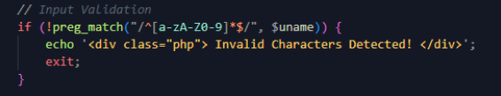



InputValidation
Stringent validation of user input to prevent the injection of malicious characters or SQL commands.

Slide 6

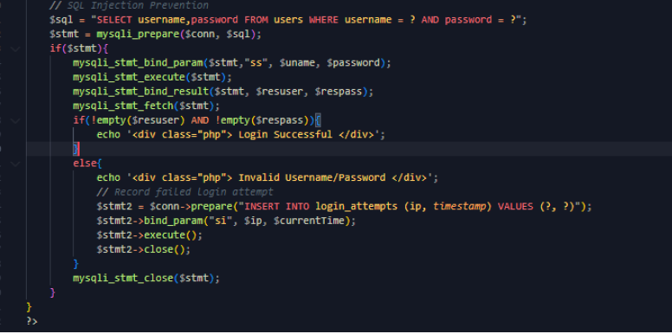
Parameterized Queries
Adoption of parameterized queries or prepared statements to separate SQL code from user input, preventing direct execution of injected SQL commands.

Slide 7

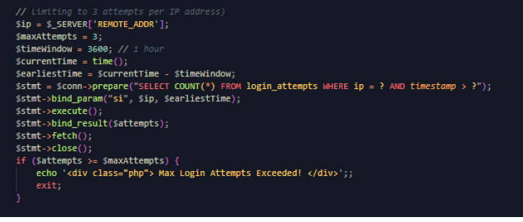
Query Time Limits
Implementation of query time limits to thwart time-based SQL injection attacks by restricting the execution time of SQL queries.

Slide 8

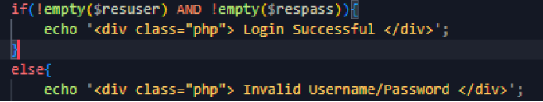
Error Handling
Minimization of verbose error messages to prevent disclosure of sensitive information that could aid attackers in exploiting SQL injection vulnerabilities.

Slide 9
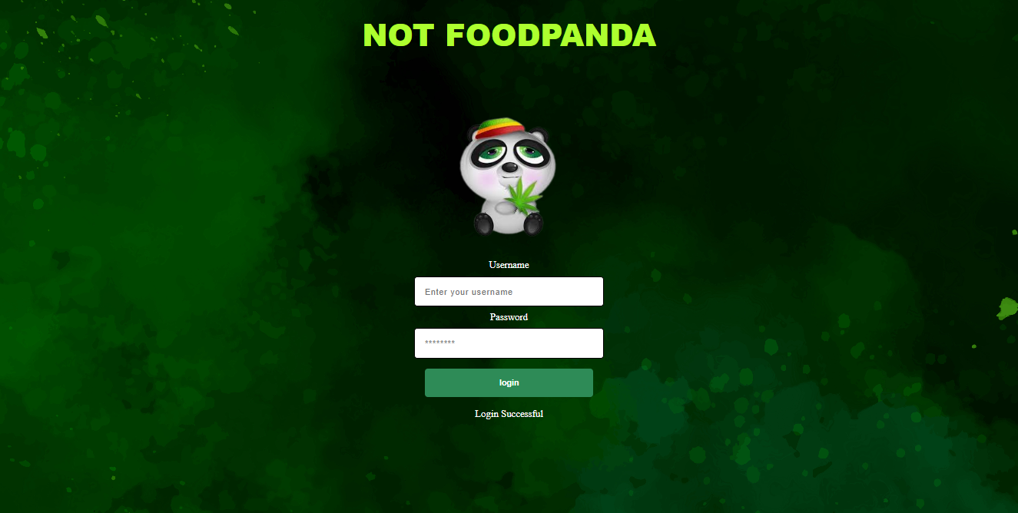
Implementation/Demo

Slide 10



Conclusion
The project demonstrates the importance of implementing comprehensive security measures to mitigate SQL injection vulnerabilities in web applications effectively. By combining input
validation, parameterized queries, query time limits, and continuous monitoring, the project provides robust protection against various types of SQL injection attacks. Future enhancements may include additional security features such as web application firewalls and intrusion detection systems to further fortify the application's defences against evolving cyber threats.

Slide 11











Thanks!

